Slide 1
The Primary Keys
COS 221 Assignment 5
Notes:
Adriano speak ->
My name is adriano and i am the Team Leader of the primary keys

Slide 2
Agenda
Meet the team
Documentation
System overview
Security
Database Population
Demo
Questions
Notes:
Adriano speak
Here is Today’s agenda,
We will show the team members, followed by a quick runthrough of documentation
Then we will explain how the system works on a high level
We will then explain some security measures taken to provide database protection
Then we have software used for database population,
And the most exciting part the demo
please refrain from asking questions until the end

Slide 3
Meet the team
Dewald Colesky - API & Documentation
Adriano Jorge - Team Leader - All
Zoe Joubert - UI & JS
Inge Keyser - UI & JS & Documentation
Megan Lai - UI & JS
Johan Nel - API & JS & Documentation
Connor Bell - UI & JS
Notes:
Adriano speak -> no need to introduce the members, when they speak they should introduce themselves

Slide 4
Documentation
Initial planning
ER Diagrams
Functional Requirements
ReadME
Notes:
Initial planning can be found on the github if wanted to read through

Slide 5
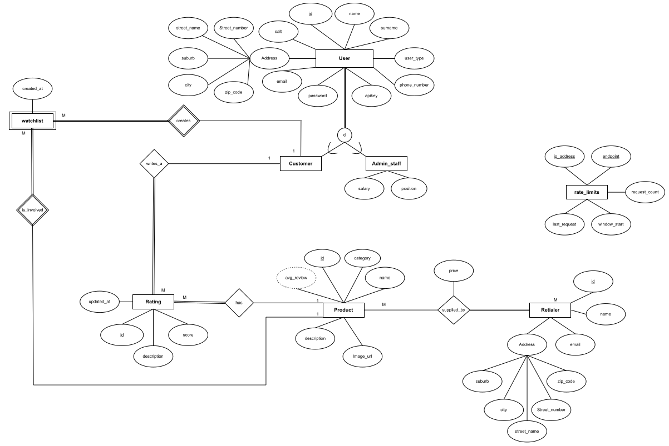
Documentation cont. (ER)
Notes:
overview

Slide 6
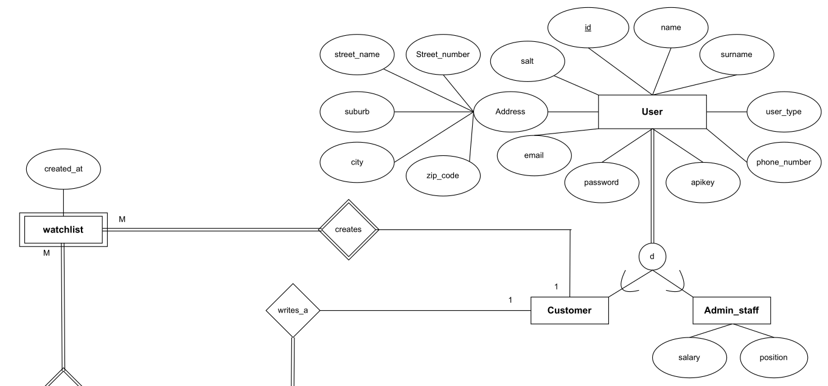
Notes:
User -> (creates) -> watchlist

Slide 7
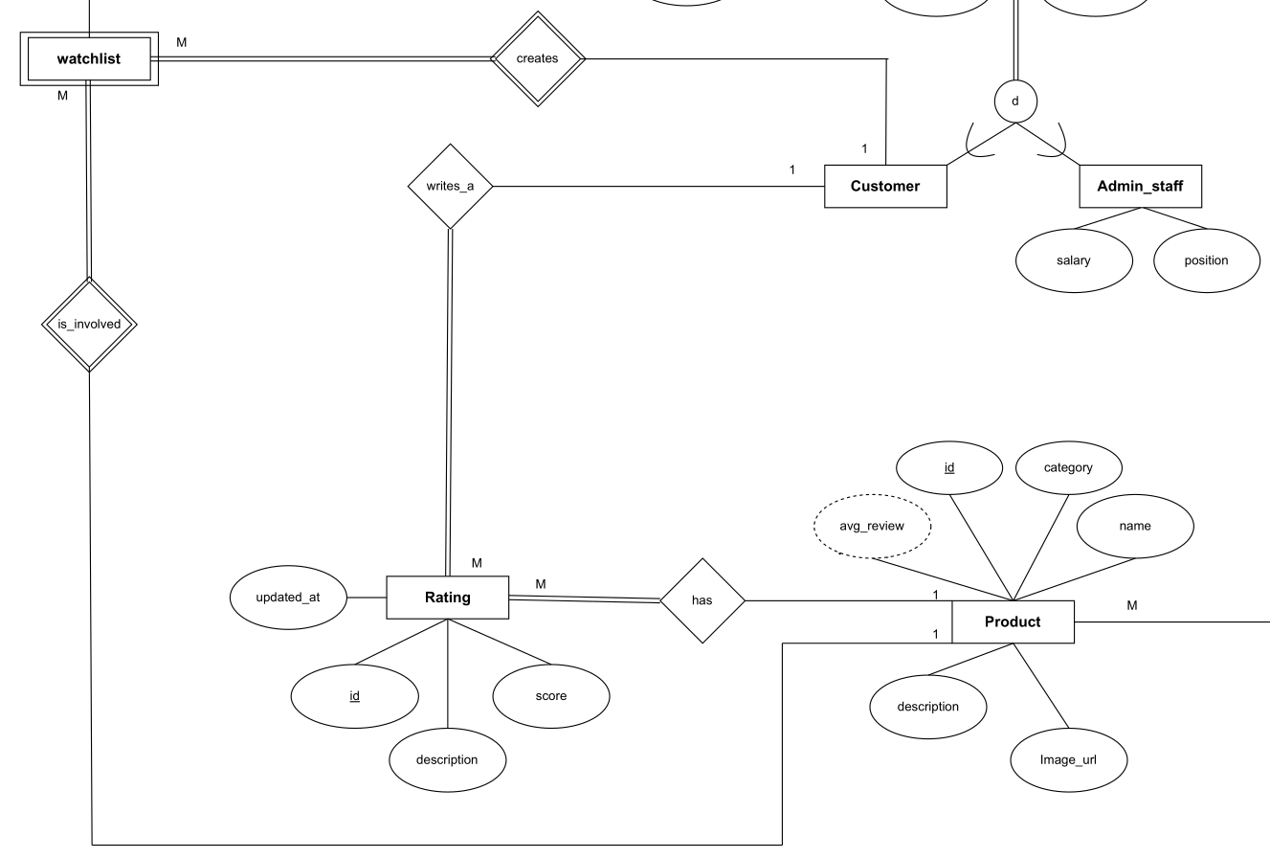
Notes:
Watchlist -> (is involved) -> product
Rating-> (has) ->product
Customer -> (writes a) -> Rating

Slide 8
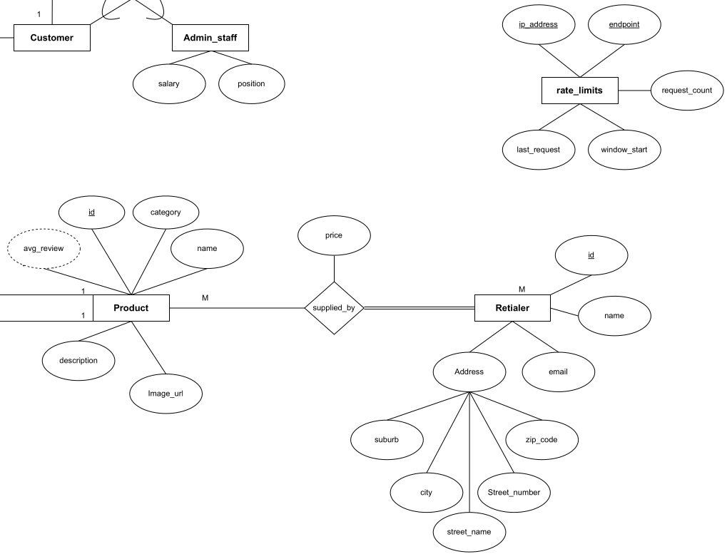
Notes:
Rate limits
Product-> (supplied by) -> retailer

Slide 9
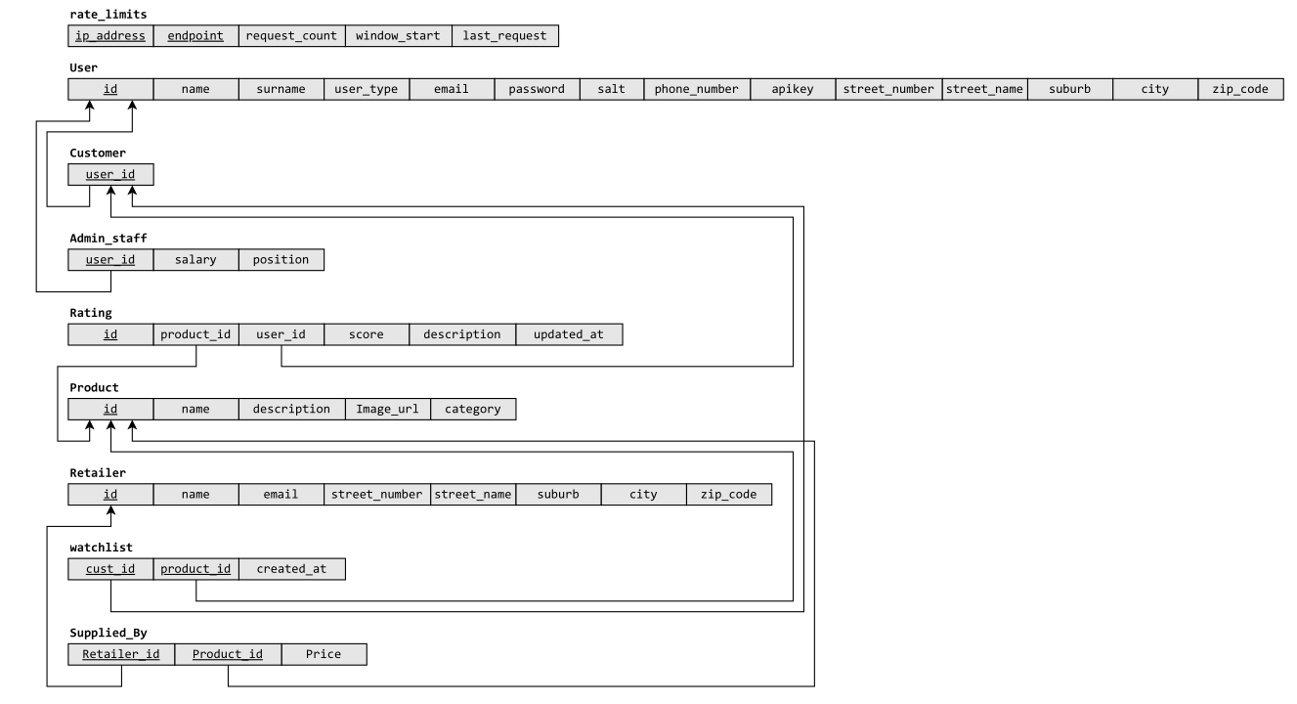
Documentation cont. (Relational Mapping)

Slide 10
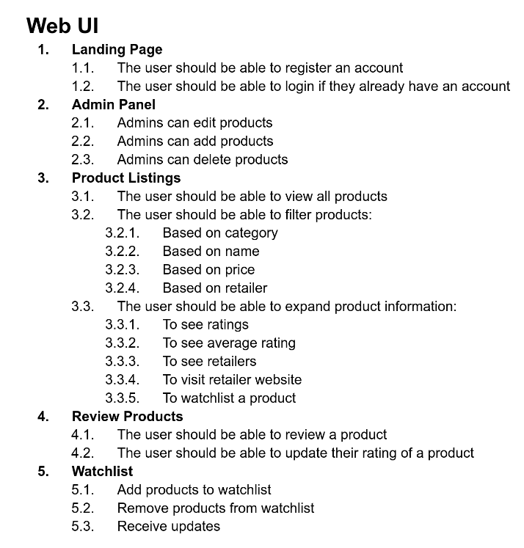
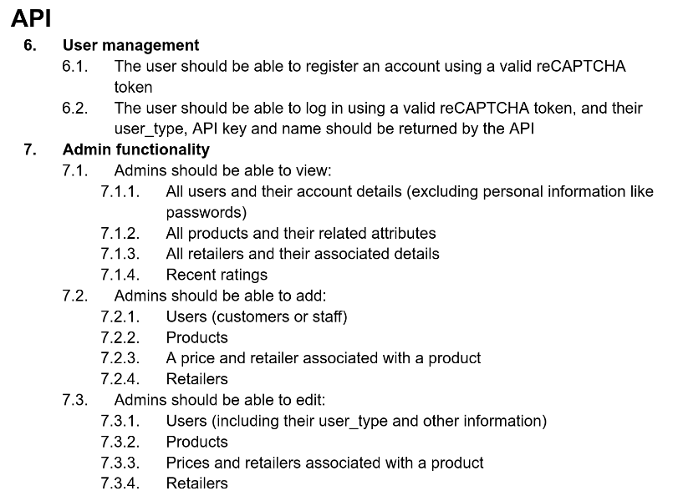
Documentation cont. (Functional Req.)
Notes:
This is how FR looks and we recommend reading through the documentation to get all requirements in depth.
Core functionality:
Users can login
Admins can manage users
Admins Make changes to products
Users Filter products
Users View products
Users review products

Slide 11
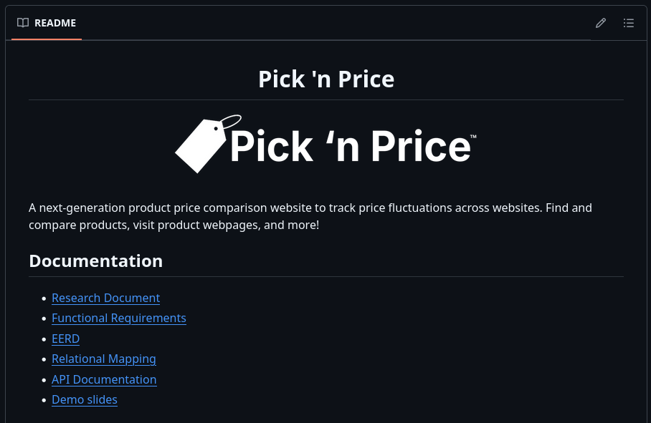
Documentation cont. (ReadME)
Notes:
** To be updated
Preview of readme
All documentation can be found on the github repository

Slide 12
System Overview
Technologies used:
API (PHP)
Frontend(PHP, HTML, JS, CSS)
Database (PHP my admin)
Hosting (wheatley)
Notes:
How does the system work?

Slide 13
Security
API endpoints make use of
Prepared statements
Parameter binding
Input validation
To (help) protect against SQL injection attacks
API keys are used to (help) prevent unauthorized users from changing the database
Passwords are hashed, and stored with a salt, to (help) prevent dictionary attacks

Slide 14
Database Population
Custom scripts for Rating, Product, Supplied_By
Product images fetched from https://www.pexels.com/
https://www.mockaroo.com/ for Retailer
Other data is generated by users (User, Customer, Watchlist, etc.)

Slide 15
Demo
Notes:
Login with admin, view review graphs, remove a product, add a product
Login with a user, browse products, review a product, watchlist the admins added product

Slide 16
Questions?

